Slide 1

Be Caring
Jonah
Dr. Rick Griffith • Crossroads International Church Singapore
BibleStudyDownloads.org

Slide 2

A missed opportunity
Notes:
In June 1991 a car in Singapore's East Coast area hit a 70-year-old Chinese man. The owner of the car was relieved to find a doctor at his clinic just a short distance away. When the doctor was begged to try to save the man's life, he replied that he was too busy, didn't have the right equipment, and needed the victim's approval or his family's approval before he would treat him. The doctor never tried to see the old man, who died five hours later.

Slide 3

Do you care for people?
Notes:
I was shocked to read the account in the newspaper. How could anyone be so unfeeling—especially someone who has given himself to the "people's profession"? Would you have helped him? Do you care for people?

Slide 4
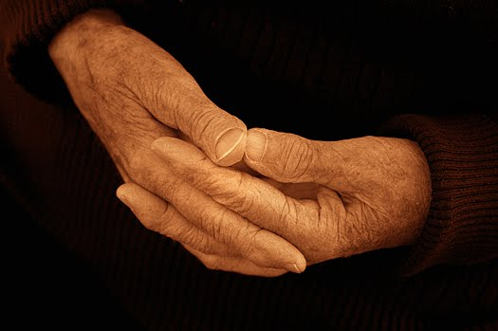
How does God want us to respond to unresponsive people?
Notes:
How does God want us to respond to unresponsive people? Such an incident is all too common. In fact, today we will take a look at a biblical character with this same unfeeling attitude. As we do so, I believe that God will challenge us with four principles on our own need to show compassion for other people.

Slide 5
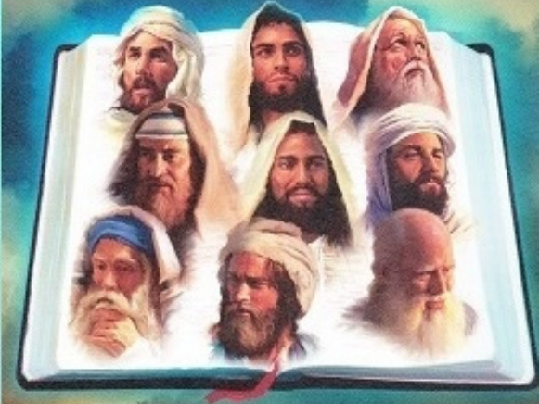
The Twelve
Courage to Confront Culture
—A Preaching Series on the Minor Prophets—
Notes:
Today we continue with part 2 of our series on the Minor Prophets that I'm calling simply "The Twelve."

Slide 6
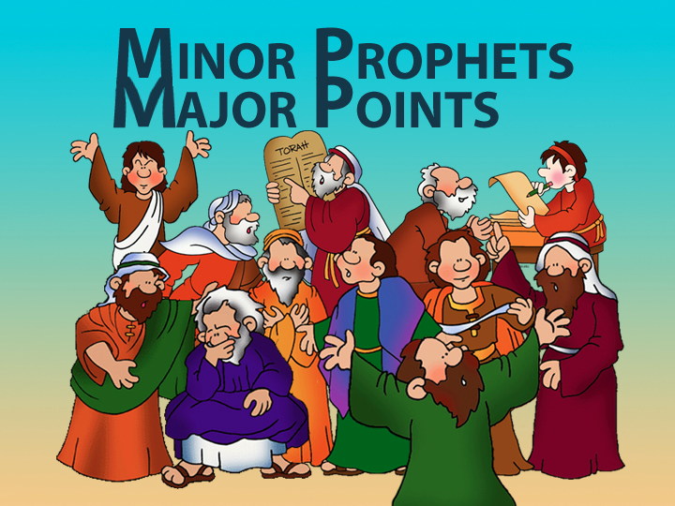
Minor Prophets—Major Points

Slide 7

Title Slide
JONAH

Slide 8
Unique Elements in Jonah
600
Unique Elements in Jonah
    Jonah speaks entirely through the experience of a prophet—not his words.
    Jonah is the only prophet in Scripture who tried to run from God.
    Jonah is the only entire biblical book on Israel's response to the Gentile nations.
    4. The historicity of Jonah has been denied by many scholars.

Slide 9
"Go! No! So Row!"
Jonah 1
God turns events to show us His compassion for people.
Notes:
The Lord shows His care for people by events that get our attention.

Slide 10
Jonah 1: Go!
604
God commands His people to tell the wicked how much He hates their sin (1-2).
Notes:
God commissioned Jonah to share His righteousness with Nineveh (1:1-2).

Slide 11
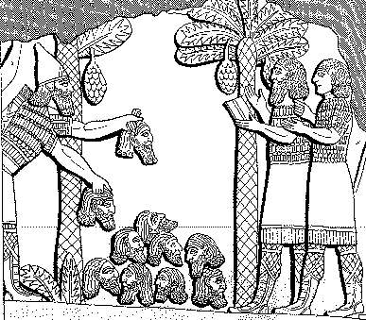
Assyrian Brutality
Assyrian
614
Brutality
"A pyramid of heads I reared in front of his city. Their youths and their maidens I burnt up in the flames."
Shalmaneser, 859-824 BC
= 80 years before Jonah, in
Luckenbill, Ancient Records of Assyria and Babylonia, 1:213

Slide 12
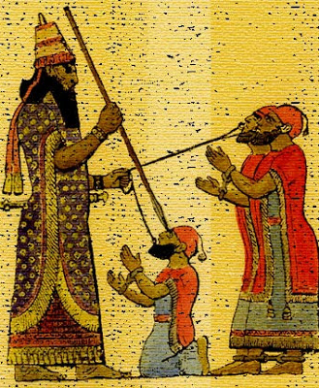
Treatment of Captured Kings
614
"Assyrian execution might involve tortures such as flaying…pulling out the lying tongue, burning, or…"
"I pierced his chin with my keen hand dagger. Through his jaw… I passed a rope, put a dog chain upon him and made him occupy a kennel."
Ashurbanipal, 669-626 BC
= 100 years after Jonah, in
Luckenbill, Ancient Records of
Assyria & Babylonia, 2:319

Slide 13
Esarhaddon's Ego (660 BC)
614
"I am powerful, I am all powerful,
I am a hero, I am gigantic, I am colossal, I am honored, I am magnified, I am without equal among all kings, the chosen one of Asshur, Nabu, and Marduk!"
Luckenbill, Ancient Records of Assyria and Babylonia, 2:226

Slide 14
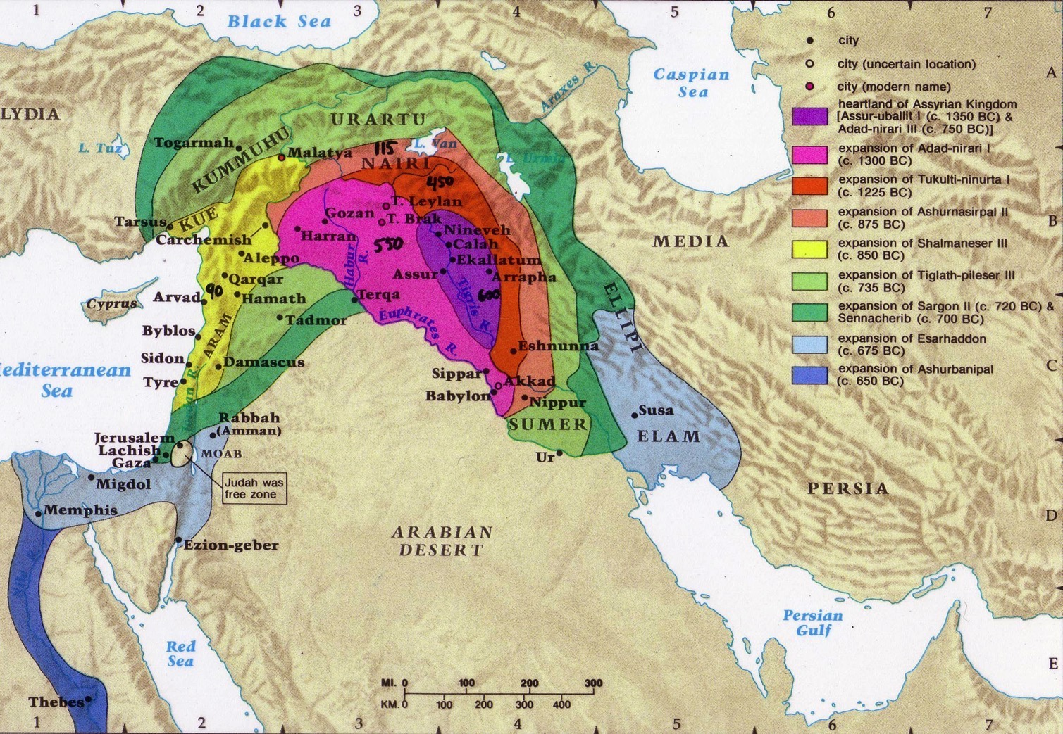
Assyrian Expansion
607

Slide 15
The Setting: Assyrian Might
443
Strong 883-783
Strong 745-626
Weak 790-745
900
850
800
750
70 0
65 0
600
550
500
Jonah

Slide 16
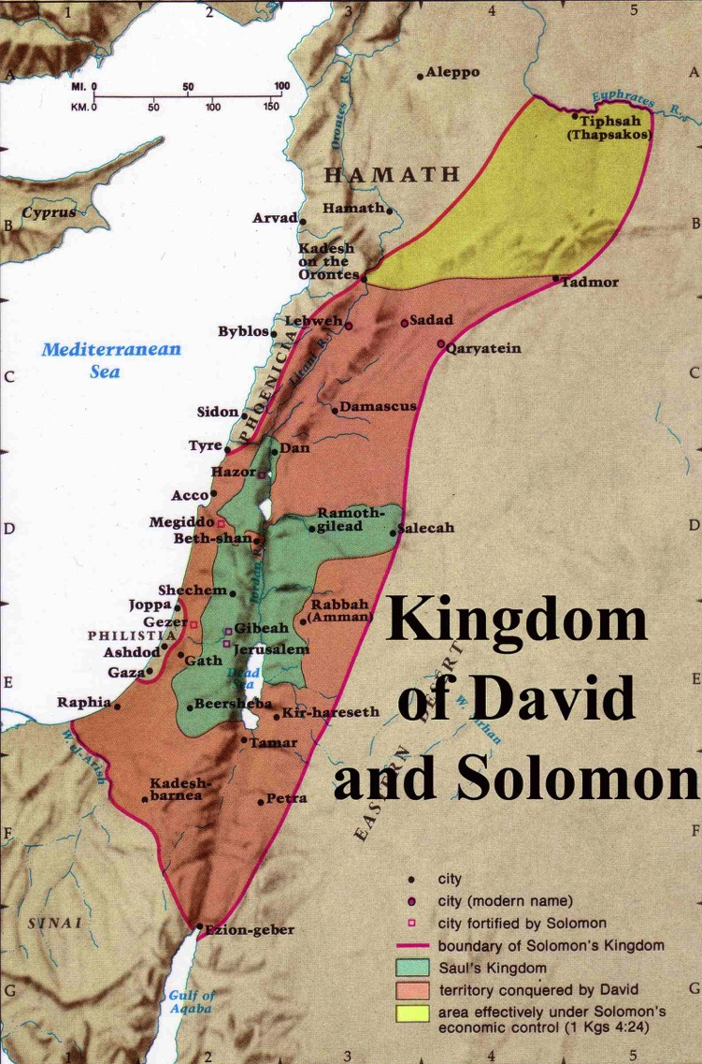
Expansion under Jeroboam II
446
Jeroboam II
"Jeroboam II recovered the territories of Israel between Lebo-hamath and the Dead Sea,* just as the Lord, the God of Israel, had promised through Jonah son of Amittai, the prophet from Gath-hepher."
(2 Kings 14:25 NLT).
* Hebrew the sea of the Arabah
Jeroboam I (930 BC)
Kingdom of Saul
Kingdom of David
Notes:
The boundaries under Jeroboam II went even farther than David and Solomon, who only had tribute sent from Hamath.
____________
BE-32-Jonah-16
OS-30-Amos-14
OS-32-Jonah-40

Slide 17

God loves you and offers a wonderful plan for your life?
Notes:
Not exactly Law #1: God loves you and has a wonderful plan for your life

Slide 18
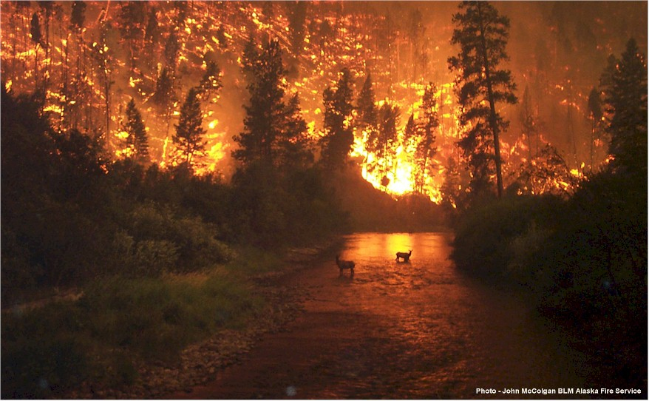
What a Message…
Jonah's Message…
"Nineveh's bad and God's mad!
You better turn or you're gonna burn!"

Slide 19
Jonah 1: Go! No!
God commands His people to tell the wicked how much He hates their sin (1-2).
God's people often don't want to tell bad people that they're bad (3).

Slide 20

Where would Jonah go?
Tarshish
Nineveh
Gath-Hepher
Joppa

Slide 21
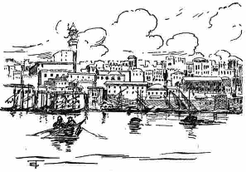
Joppa was an important seaport
Going down to Joppa was the way to get out of Israel by ship—unlike Peter 800 years later

Slide 22
Jonah 1: Go! No! So Row!
God commands His people to tell the wicked how much He hates their sin (1-2).
God's people often don't want to tell bad people that they're bad (3).
Neglecting evangelism brings consequences (4-16).

Slide 23
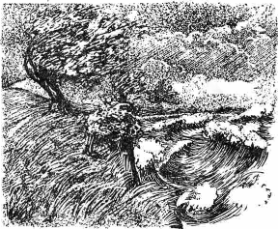
Raging Sea
Notes:
⁴ But the Lord hurled a powerful wind over the sea, causing a violent storm that threatened to break the ship apart. NLT

Slide 24
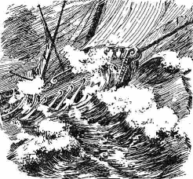
Ship Threatened to Break
Notes:
The Hebrew reads that the ship itself threatened to break up!

Slide 25
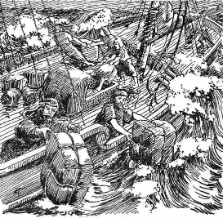
Cargo Overboard
Notes:
⁵ Fearing for their lives, the desperate sailors shouted to their gods for help and threw the cargo overboard to lighten the ship. NTL
The Bible in Pictures, drawn in 1922 but free to copy at www.creationism.org/books/

Slide 26
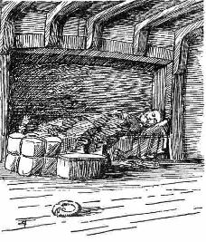
Jonah Sleeping
Notes:
But all this time Jonah was sound asleep down in the hold. ⁶ So the captain went down after him. "How can you sleep at a time like this?" he shouted. "Get up and pray to your god! Maybe he will pay attention to us and spare our lives."
NLT, Jon 1:5-6.
The Bible in Pictures, drawn in 1922 but free to copy at www.creationism.org/books/

Slide 27

Black
⁷ Then the crew cast lots to see which of them had offended the gods and caused the terrible storm. When they did this, the lots identified Jonah as the culprit.
⁸ "Why has this awful storm come down on us?" they demanded. "Who are you? What is your line of work? What country are you from? What is your nationality?"
⁹ Jonah answered, "I am a Hebrew, and
I worship the Lord, the God of heaven, who made the sea and the land" (1:7-9 NLT).

Slide 28
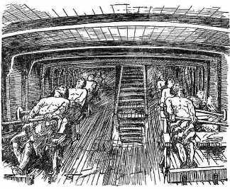
Sailors Rowing
Notes:
¹³ Instead, the sailors rowed even harder to get the ship to the land. But the stormy sea was too violent for them, and they couldn't make it (1:13 NLT).
The Bible in Pictures, drawn in 1922 but free to copy at www.creationism.org/books/

Slide 29
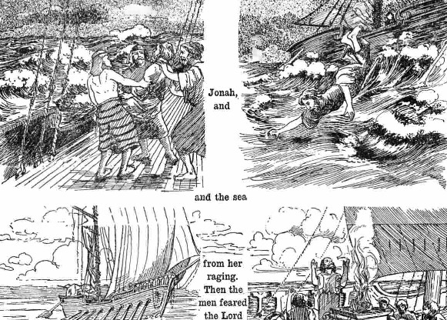
Jonah Overboard
Notes:
¹⁴ Then they cried out to the Lord, Jonah's God. "O Lord," they pleaded, "don't make us die for this man's sin. And don't hold us responsible for his death. O Lord, you have sent this storm upon him for your own good reasons."
¹⁵ Then the sailors picked Jonah up and threw him into the raging sea, and the storm stopped at once! ¹⁶ The sailors were awestruck by the Lord's great power, and they offered him a sacrifice and vowed to serve him (Jon 1:14-16 NLT).

Slide 30
God often used invasions of His people to convert the invaders!
Periods of Christian Expansion
Period 1
Period 2
Period 3
Period 4
Period 5
Ends of
Earth
Romans
Barbarians
Vikings
Saracens
0
400
800
1200
1600
2000
Ralph Winter, The World Christian Movement
Notes:
God has used invasions by pagan peoples to bring them the gospel. The Romans received the gospel from the early church, but kept it to themselves, so in the fifth century God had the barbarians to the north invade Rome. The result? Roman slaves shared Christ and won the barbarians to Christ! Four hundred years later the same thing happened. The barbarians, then Christian, refused to reach out to the Vikings to the north, and the Vikings invaded Europe and became Christians in the process! So who has invaded your life for God to use you?! Perhaps some international students?

Slide 31
Main Idea of Jonah 1
Neglecting evangelism brings consequences
God still uses means today to show us His seriousness about evangelism

Slide 32
The Ten Million Dollar Question
The Ten Million Dollar Question
How should we respond to God's goodness despite our sin?

Slide 33
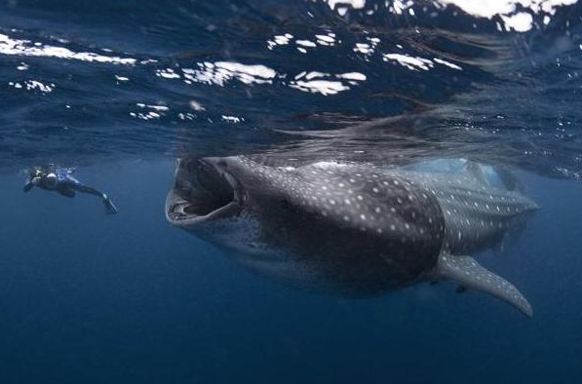
"Lo!" Jonah 2
Thank God for His compassion on you—despite your sin.
Notes:
33
Your response to God's mercy on you as a sinful creature should be gratefulness.

Slide 34
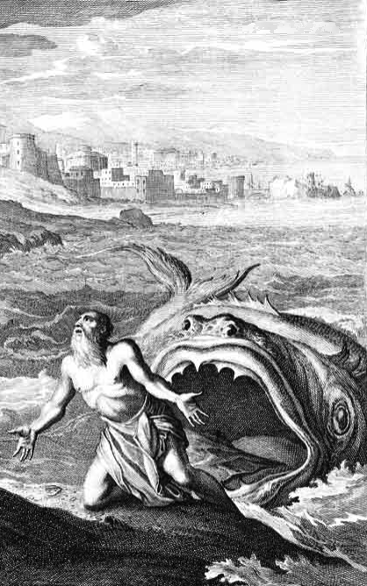
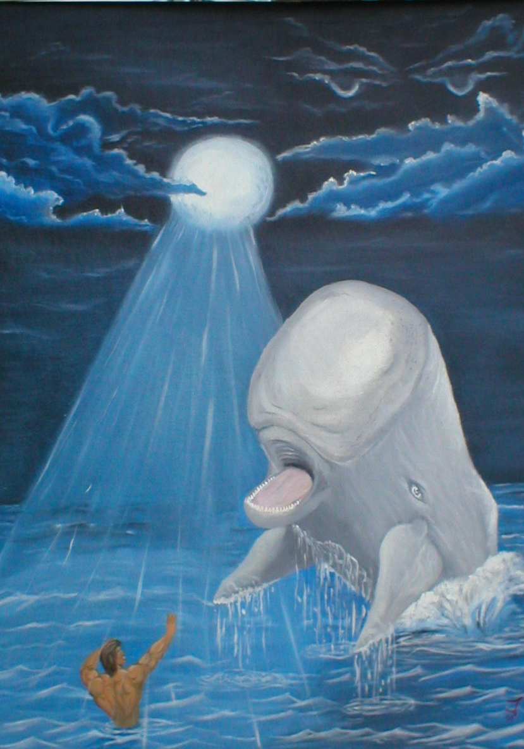
Huge Fish?
or Whale?
The Bible:
Dag ("fish")
Notes:
34

Slide 35
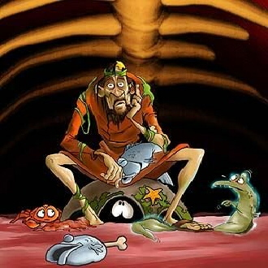
Inside the Fish
Notes:
35
What would he eat? I hope he liked sea food!
Could he really breathe in there? Wouldn't the oxygen run out?
No, provided an eco-system!

Slide 36
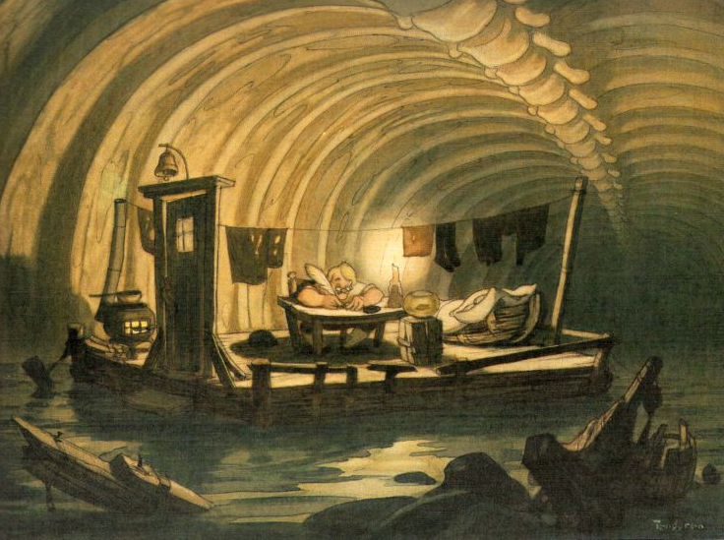
Inside the Fish
Notes:
36
Some think that Jonah had a writing ministry because of the things written in chapter 2. But I tend to think that these were written down later!
I'm not sure that he had a desk and lamp inside the fish.
Actually, the next slide is the best picture that I have seen that shows what it look like inside the fish…

Slide 37
Black
Notes:
37
Yeah, this is what it look like inside the fish.
But sometimes in the dark we see the light!
This is what happened to Jonah where the light finally turned on in his thinking.
We have this recorded in chapter 2.

Slide 38
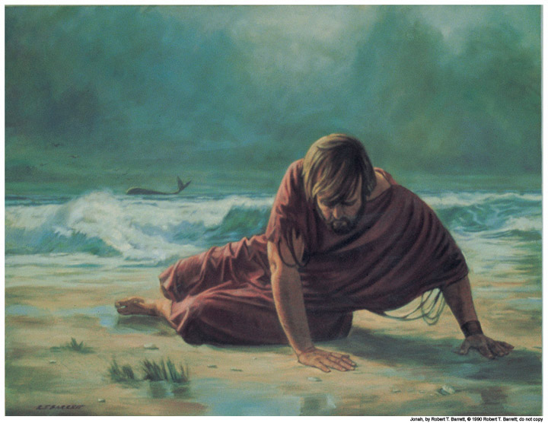
Jonah thanked God for delivering him from drowning (1:17–2:10)
Wouldn't you?

Slide 39
Judgment?
Deliverance!
Notes:
39
Was the fish God's judgment on Jonah? Not at all!
It was the means of deliverance!

Slide 40
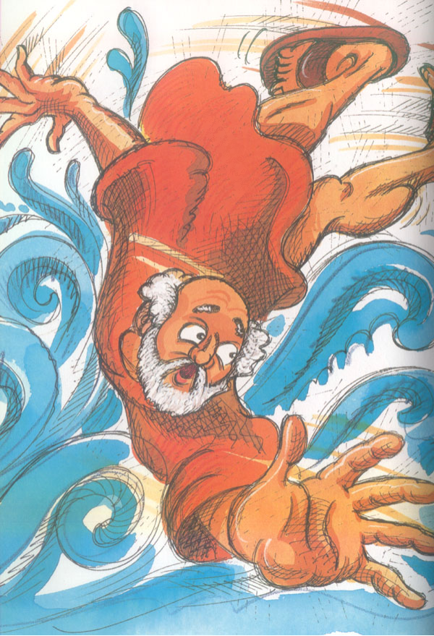
Thanksgiving Psalm
Prayer (1-2)
Lament (3-7)
Vow (8-9)
Jonah 2
Notes:
40
Jonah 2 sounds much like a psalm in the book of Psalms. That is because it has the typical Hebrew structure of a thanksgiving psalm.

Slide 41
Thanksgiving Psalm
Prayer (1-2)
"In my distress I called to the LORD and he answered me…"
Jonah 2
Notes:
41

Slide 42
Thanksgiving Psalm
Prayer (1-2)
Lament (3-7)
"You hurled me…"
(2:3, cf. 1:4, 5, 12, 15)
Jonah 2
Notes:
42

Slide 43
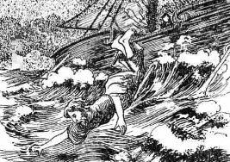
"Down" in Jonah
"went down to Joppa" (1:3a)
"had gone down below deck" (1:5)
"sank down to the roots of the mountains" (2:6)

Slide 44
Thanksgiving Psalm
Prayer (1-2)
Lament (3-7)
Vow (8-9)
Jonah 2
Notes:
44

Slide 45

Jonah's Vow
"But I, with a song of thanksgiving, will sacrifice to you. What I have vowed I will make good. Salvation comes from the LORD" (2:9 NIV)

Slide 46

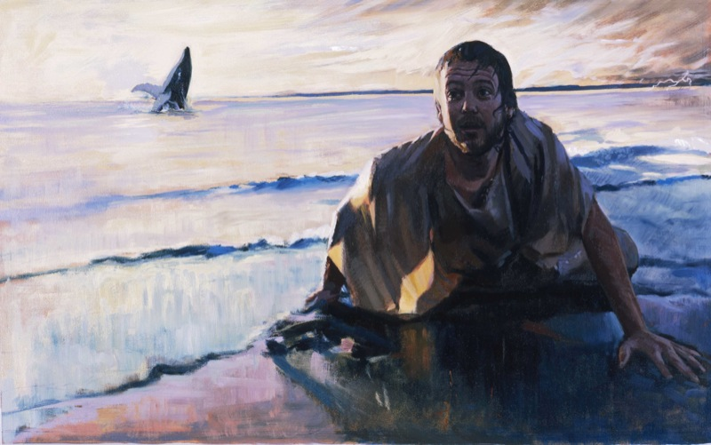
The Result? Jonah Vomited
DRESSING
THE
STAGE
MS
SG
ER
"THE LAND"
DS
PG
RS
Handbook pg. 15-16
25
Notes:
46

Slide 47
The Ten Million Dollar Question
The Ten Million Dollar Question
How should we respond to God's goodness despite our sin?

Slide 48
We should thank God that He spares us despite our disobedience

Slide 49
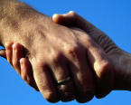
Distinguishing some key terms…
Grace: God gives us what we don't deserve
Mercy: God doesn't give us what we do deserve
Justice: God gives us what we do deserve
Notes:
49
So what have I learned? Everything I am, have, and do—it's all because of God's grace. Who would have ever thought that this shy boy—from a broken home whose parents and those they have married have endured 12 divorces—who would ever thought that this guy would be privileged to serve Him at SBC and beyond?

Slide 50

The Big Idea
The Big Idea of Jonah 2
Thank God
His mercy overshadows His justice

Slide 51
"Go! Yo! Whoa!"
Jonah 3
Share God's message since people are responsive.
Notes:
51

Slide 52

Success - Failure
SUCCESS
FAILURE
Notes:
52
Susan's 10th HS reunion had one student retire at age 28
Christopher Lee's HS reunion in HK passed out business cards—"vice president...CEO…Prime Minister" then "SBC prof" so they paid for his lunch
Dad's 25th HS reunion—man voted most likely to succeed could not come as the warden would not let him out of prison!

Slide 53
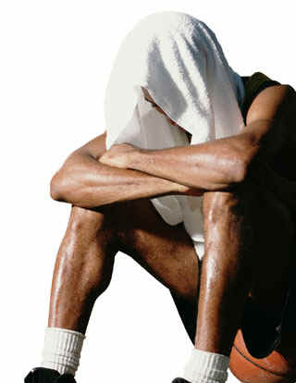
Do you fear
f
a
i
l
u
r
e
?
Notes:
53
One western journalist referred to Singapore as a "city of fear"—fear of breaking the law, fear of not making the grade, fear of not having enough money, etc.
Years ago Lee Kuan Yew noted that Singaporeans are not risk-takers in business.

Slide 54
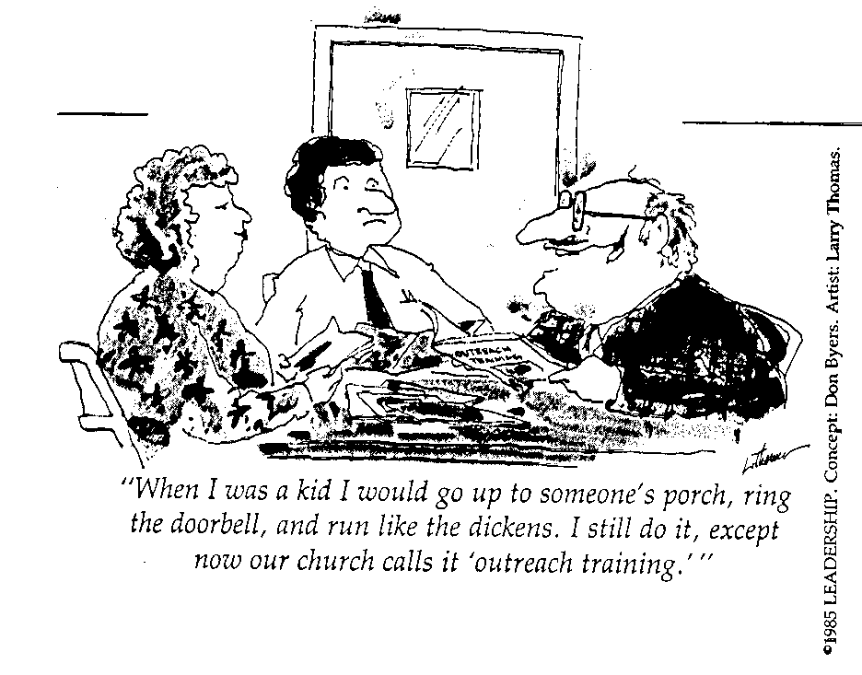
Many Fear Evangelism!
"When I was a kid I would go up to someone's porch, ring the doorbell, and run like the dickens. I still do it, except now our church calls it 'outreach training.'"

Slide 55
How does God look at failure–especially in evangelism?
Notes:
What does the Lord think of us when we ignore his promptings to witness?
How does he respond when we are unfaithful in bringing his message?
55

Slide 56

Jonah failed to go at first
Notes:
If anyone knows about failure, it's Jonah !
56

Slide 57
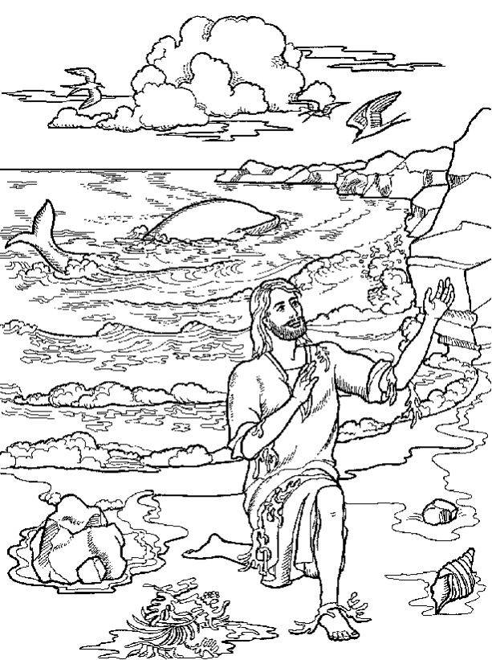
Jonah 3: Go!
GO! God is the God of the second chance for unfaithful messengers (1-2).
Notes:
57
In his grace he doesn't beat us over the head when we fail to witness—he often gives us more opportunities
Then the Lord spoke to Jonah a second time: ² "Get up and go to the great city of Nineveh, and deliver the message I have given you." (3:1-2 NLT)

Slide 58
"You cannot find a single place in Scripture where a man was ever sent to do a work in which he failed"
––D. L. Moody

Slide 59
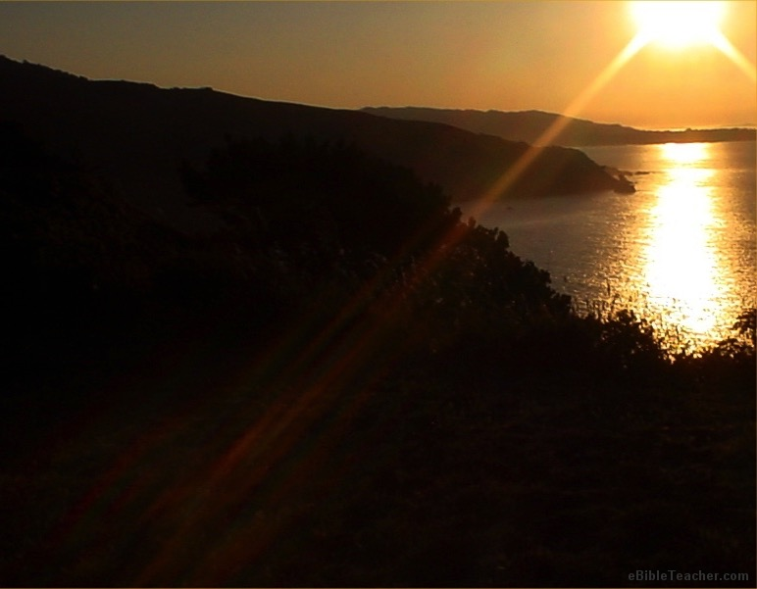
The God of the "Second Chance"
Abraham
Moses
David
Paul
John Mark

Slide 60
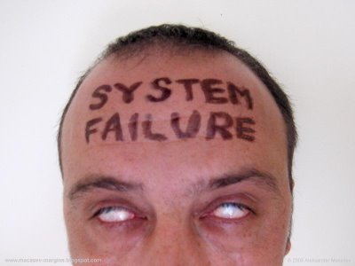
Failure is an event—Not a person
Notes:
60

Slide 61
Jonah 3: Go! Yo!
GO! God is the God of the second chance for unfaithful messengers (1-2).
YO! God's people especially need to declare His message to those who have never heard (3-4).
Notes:
61

Slide 62



The Nineveh Metropolis
602
Rehoboth Ir
Size of Singapore
Nineveh Proper
The Great City of Nineveh
Resen
Calah
Genesis 10:11-12
0
kilometers
20
Notes:
"This time Jonah obeyed the Lord's command and went to Nineveh, a city so large that it took three days to see it all" (3:3 NLT).
There's a problem here regarding the three-day's journey (cf. OTS, 602). Nineveh's inner wall was less than eight miles, so the diameter of the city was only two miles—hardly a three-day journey. One day's journey in the open was usually 15-20 miles (Hannah, BKC, 1:1463).
But this isn't really a problem in either of two ways:
"The great city of Nineveh" (1:2; 3:2; cf. 4:11) almost surely included three other towns in the vicinity as well. Four cities (Nineveh, Rehoboth Ir, Calah, and Resen) are mentioned in Genesis 10:11-12 as "the great city" and they still exist today with different names (Kouyunjik, Khorsbad, Nimroud, and Karamles). This can be observed on the following map by Austin Henry Layard, Nineveh and Its Remains, 2:40.
If we superimpose a map of Singapore over it, we can see that walking through Nineveh would be like walking in Singapore from the far north in Yishun to Harbourfront in the south. That could take 3 days easily!
62

Slide 63
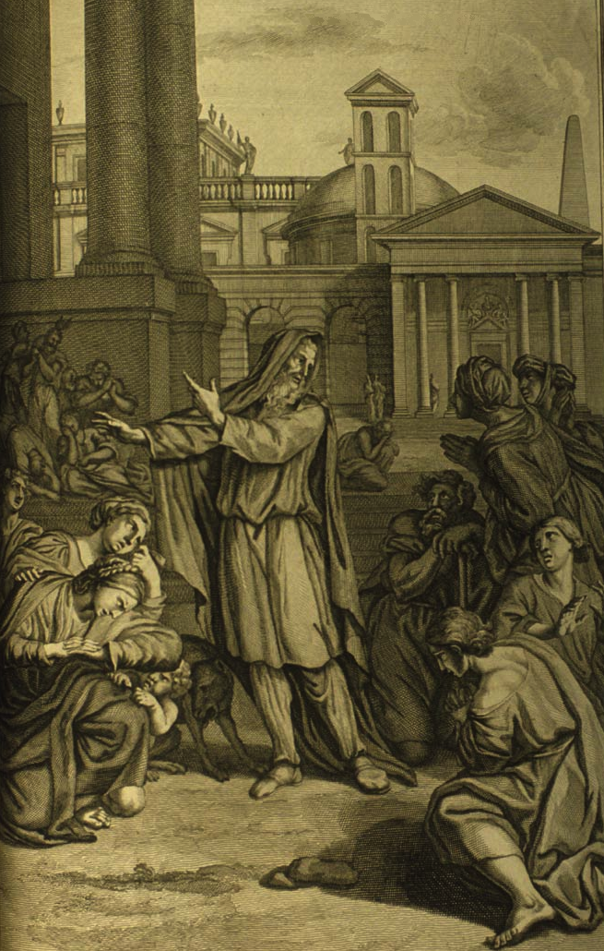

"Now 40 days and Nineveh overturned!"
(Hebrew message in 5 words)
`tk,Ph.n< hwEßn>ynI)w> ~Ayë ~y[iäBr>a; dA[
Notes:
63
http://www.mythfolklore.net/lahaye/150/LaHaye1728Figures150JonahIII4JonahEntersNiniveh.jpg

Slide 64
Jonah 3: Go! Yo! Whoa!
GO! God is the God of the second chance for unfaithful messengers (1-2).
YO! God's people especially need to declare His message to those who have never heard (3-4).
WHOA! The results of sharing about God are often surprisingly positive (5-10).
Notes:
64
⁵ The people of Nineveh believed God's message, and from the greatest to the least, they declared a fast and put on burlap to show their sorrow.
⁶ When the king of Nineveh heard what Jonah was saying, he stepped down from his throne and took off his royal robes. He dressed himself in burlap and sat on a heap of ashes. ⁷ Then the king and his nobles sent this decree throughout the city:
"No one, not even the animals from your herds and flocks, may eat or drink anything at all. ⁸ People and animals alike must wear garments of mourning, and everyone must pray earnestly to God. They must turn from their evil ways and stop all their violence. ⁹ Who can tell? Perhaps even yet God will change his mind and hold back his fierce anger from destroying us."
¹⁰ When God saw what they had done and how they had put a stop to their evil ways, he changed his mind and did not carry out the destruction he had threatened (3:5-10 NLT)

Slide 65
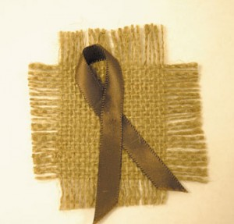
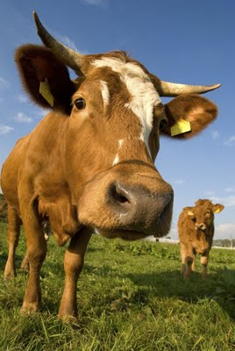

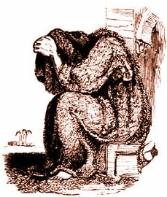
"What did I do?"
Jonah 3:5-10
Notes:
65
⁵ The people of Nineveh believed God's message, and from the greatest to the least, they declared a fast and put on burlap to show their sorrow.
⁶ When the king of Nineveh heard what Jonah was saying, he stepped down from his throne and took off his royal robes. He dressed himself in burlap and sat on a heap of ashes. ⁷ Then the king and his nobles sent this decree throughout the city:
"No one, not even the animals from your herds and flocks, may eat or drink anything at all. ⁸ People and animals alike must wear garments of mourning, and everyone must pray earnestly to God. They must turn from their evil ways and stop all their violence. ⁹ Who can tell? Perhaps even yet God will change his mind and hold back his fierce anger from destroying us."
¹⁰ When God saw what they had done and how they had put a stop to their evil ways, he changed his mind and did not carry out the destruction he had threatened (3:5-10 NLT)

Slide 66
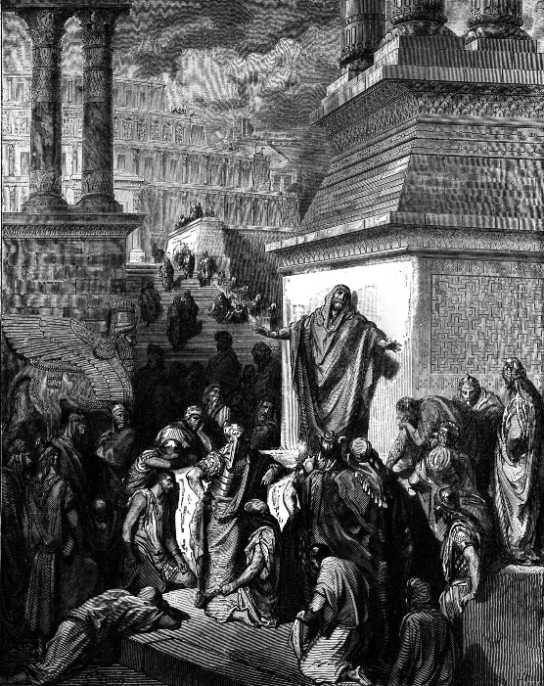
Jonah in Wonderland?
"And what a wonderful result followed his preaching! The greatest prophets in Israel had not been able to accomplish anything like this… We are in wonderland! Surely this is not the record of actual historical events nor was it ever intended as such. It is a sin against the author to treat as literal prose what he intended as poetry"
(Julius A. Bewer, A Critical and Exegetical Commentary on Jonah, ICC, 3-4).
Notes:
66
http://www.mythfolklore.net/lahaye/150/LaHaye1728Figures150JonahIII4JonahEntersNiniveh.jpg

Slide 67
Preparation for Repentance?
605
Events Leading to Nineveh's Repentance in 758 BC:
787 Monotheistic worship of Nabu started
765 Plague throughout Assyria
763 Revolt in the city of Asshur
763 Eclipse of the sun
762 Revolt in the city of Asshur
761 Revolt in the city of Arrapha
760 Revolt in the city of Arrapha
759 Another plague
758 "Peace in the land" (repentance under Jonah?)
Notes:
67

Slide 68
People are more responsive than you think!
The Main Idea of Jonah 3
Notes:
Tom Roxas led the murderer of his brother Nino to Christ.
Ralph Neighbor's Singapore survey of why people aren't Christians led him to weep at his desk as 85% said, "No one has ever explained to me the issues involved."
"If you don't show, you'll never know."
"Most of us are so full of tact that we never make contact" —George Sweeting, MBI

Slide 69
Book Chart
599
God's Compassion on Gentiles
Disobeys Missionary Mandate |  |  |  | Obeys Missionary Mandate
Chapters 1–2 |  |  |  | Chapters 3–4
God's Mercy on Jonah |  |  |  | God's Mercy on Nineveh
The Great Sea |  |  |  | The Great City
Commis-sioning 1:1-2 | Disobed-ience 1:3 |  | Conse-quences 1:4–2:10 | Recommis-sioning 3:1-2 | Obed-ience 3:3-4 |  | Conse-quences 3:5–4:10
"Go!" | "No!" |  | "So Row!" "Lo!" | "Go!" | "Yo!" |  | "Whoa!" "Oh No!"
Jonah's Perversity Chapter 1 |  | Jonah's Prayer Chapter 2 |  | Jonah's Preaching Chapter 3 |  | Jonah's Pouting Chapter 4
about 760 BC
Notes:
69

Slide 70
"Oh, No!" Jonah 4
Show greater compassion on people than things
Notes:
70

Slide 71
Jonah got uptight about things and forgot about people (4:1-9).

Slide 72
A. God's concern was for Nineveh, but its salvation made Jonah angry (4:1-4).
603
Key Verse
"[Jonah] prayed to the LORD, "O LORD, is this not what I said when I was still at home? That is why I was so quick to flee to Tarshish. I knew that you are a gracious and compassionate God, slow to anger and abounding in love, a God who relents from sending calamity" (4:2)
Notes:
72
Jonah's theology about God is correct—and I think 4:2 is the key verse of the book.
Most of us fear failure, but Jonah feared success! He feared that the Ninevites might repent—and they did!
But why was he angry? He wanted the people judged!

Slide 73
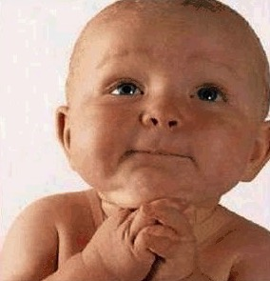
Dear God, I beg you!
Give me the Wisdom
to understand my boss.
Give me the Love
to forgive him.
Give me the Patience
to understand his deeds.
But Dearest God,
Don't give me the Power.
Because if you give me the Power…
I'll break his head
Notes:
Jonah was powerless too.

Slide 74

Hudson Taylor
Notes:
74
Like God, Hudson Taylor was a man who had compassion on lost people too [adapted from Hudson Taylor, A Retrospect, 85-87, in Evangelism notes, 18]:
Among the passengers on board the boat was one intelligent man, who in the course of his travels had been a good deal abroad, and had even visited England, where he went by the name of Peter. As might be expected he had heard something of the Gospel, but had never experienced its saving power. On the previous evening I had drawn him into earnest conversation about his soul's salvation. The man listened with attention, and was even moved to tears, but still no definite result was apparent. I was pleased, therefore, when he asked … to accompany me, and to hear me preach.
I went into the cabin of the boat to prepare tracts and books for distribution on landing with my Chinese friend, when suddenly I was startled by a splash and cry from without. I sprang on deck and took in the situation at a glance. Peter was gone! The other men were all there, on board, looking helplessly at the spot where he had disappeared, but making no effort to save him. A strong wind was carrying the junk rapidly forward in spite of a steady current in the opposite direction, and the low-lying shrub less shore afforded no landmark to indicate how far we had left the drowning man behind.
I instantly let down the sail and leapt overboard in the hope of finding him. Unsuccessful, I looked around in agonizing suspense, and saw close to me a fishing-boat with a peculiar drag-net furnished with hooks, which I knew would bring him up.
"Come!" I cried, as hope revived in my heart. "Come and drag over this spot directly; a man is drowning just here!"
"Veh bin" (It is not convenient), was the unfeeling answer.
"Don't talk of convenience!" I cried in an agony; "a man is drowning I tell you!"
"We are busy fishing," they responded, "and cannot come."
"Never mind your fishing," I said, "I will give you more money than many a day's fishing will bring; only come—come at once!"
"How much money will you give us?"
"We cannot stay to discuss that now! Come, or it will be too late. I will give you five dollars."
"We won't do it for that," replied the men. "Give us twenty dollars, and we will drag."
"I do not possess so much; do come quickly, and I will give you all I have!"
"How much may that be?"
"I don't know exactly, about fourteen dollars."
At last, but even then slowly enough, the boat was paddled over, and the net let down. Less than a minute sufficed to bring up the body of the missing man. The fisherman were clamorous and indignant because their exorbitant demand was delayed while efforts at resuscitation were being made. But all was in vain—life was extinct.
To myself this incident was profoundly sad and full of significance, suggesting a far more mournful reality. Were not those fishermen actually guilty of this poor Chinaman's death, in that they had the means of saving him at hand, if they would have but used them? Assuredly they were guilty. And yet, let us pause [before] we pronounce judgment against them lest a greater than Nathan answer, "Thou art the man." Is it so hard-hearted, so wicked a thing to neglect to save the body? [Isn't he much worse who leaves the soul to perish, and like Cain says], "Am I my brother's keeper?"
The Lord Jesus commands, commands me, commands you, my brother, and you, my sister. "Go," says He, "go ye into all the world, and preach the Gospel to every creature." Shall we say to Him, "No, it is not convenient"? shall we tell Him that we are busy fishing and cannot go? that we have bought a piece of ground and cannot go? that we have purchased five yoke of oxen, or married, or are engaged in other and more interesting pursuits, and cannot go? [Before] long "we must all appear before the judgment seat of Christ; that every one may receive the things done in his body." Let us remember, let us pray for, let us labour for the unevangelised Chinese; or we shall sin against our own souls.

Slide 75

Jonah Pouted
Jonah's concern was for a plant, so its destruction made him angry (4:5-9)
Notes:
I wonder how long he planned on staying there—forty days like in 3:4?

Slide 76
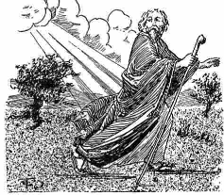
Jonah went to the east of the city
Notes:
76
You would think he would go west back to Israel, right?

Slide 77
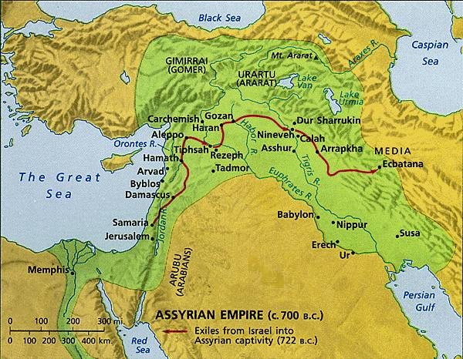
Why did Jonah sit east of the city?
607
Perhaps he thought God's judgment was going to come from Jerusalem on the west and he didn't want to be in the way!
Notes:
77

Slide 78
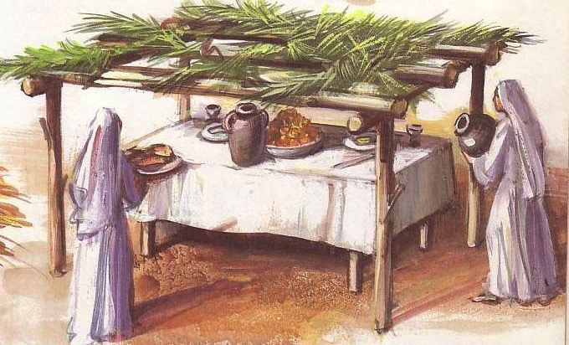
Feast of Tabernacles (Shelters)
Notes:
He knew how to make shelters since he did this once a year for the Feast of Booths when Israelites lived for a whole week in a small shelter outside their homes

Slide 79
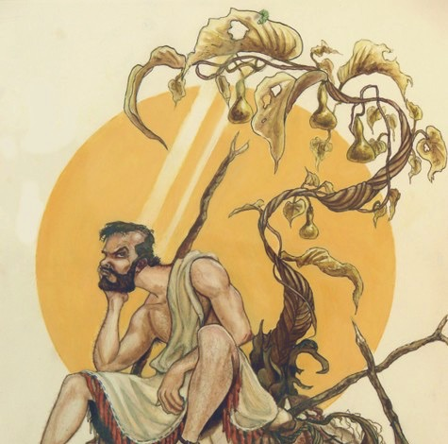
Attack & Burn
Notes:
Some think this is a castor oil plant that grows 8 feet in five months.
But this is a miraculous one that grew in but a few minutes or hours.
79

Slide 80
A play on words
God...
612
• "appointed a fish" (1:17)
• "appointed a plant" (4:6)
• "appointed a worm" (4:7)
• "appointed a wind" (4:8)
Notes:
There's a word play in Jonah with the word "appoint"…
80

Slide 81
Attack & Burn!
• "the worm attacked the plant" (4:7)
• "the sun attacked Jonah's head"
(4:8)
Notes:
There's another word play here because it literally says,
"The worm attacked the plant and the sun attacked Jonah."
What a turn of events…
81

Slide 82
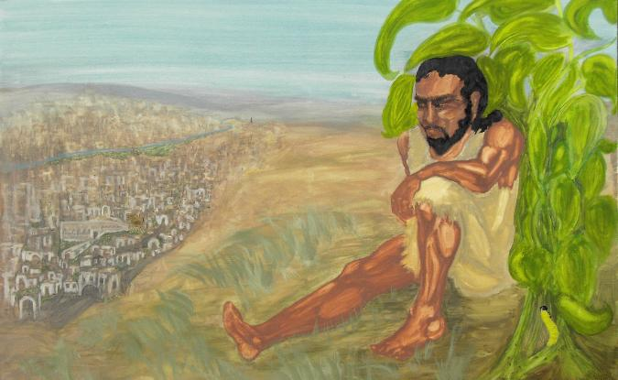
What a turn of events…
Chapter 1: Jonah's message…
"Nineveh's bad and God's mad!
You better turn or you're gonna burn!"
Chapter 4: Jonah's mean…
"God's glad and Jonah's mad!
Nineveh has turned & Jonah's burned!"

Slide 83


Put people over things (4:10-11)
Notes:
We should be "people people" rather than "things people."
Read verses 10-11
83

Slide 84

Things? or People?
Notes:
A. We, like Jonah, are often more concerned about things than people (4:10).
Actually, we don't try to be concerned for earthly things—we just try to be concerned for everything all at once. Reminds me of the old TV show where a man put a plate on a stick and begun to spin it. He got it going and then did the same with a second plate. On and on until he had about five plates. Of course, plate #1 began to wobble, so he went back to it to give it another spin. As each plate was about to fall, he'd spin it more. Eventually he had 10 plates spinning on sticks!
This reminds me of my life. Once I get a few things "spinning" well, others begin to wobble and I have to give them attention. It takes a great deal of energy to keep all the plates spinning at the same time!

Slide 85

4:10 NLT
Things? or People?
Then the Lord said, "You feel sorry about the plant, though you did nothing to put it there. It came quickly and died quickly" (4:10 NLT).
Notes:
Jonah was not spinning plates here, though.
He was actually enjoying the blessings of God's goodness. The Lord pointed out that he didn't plant or care for this plant.
I guess we also can get used to God's goodness and resent it when he takes something away—as if we deserved this blessing.
In the meantime, we are crazy about improving everything—almost.
Must we have a car—or a better car?
Renovating the kitchen tile in their house seems to really matter to people now!
A farmer advertised, "Farmer seeks wife—with tractor. When applying, please send picture…of tractor" (PRIORITIES marriage).
During a professional golf tournament, a branch fell at the green, killing a spectator below. A reporter interviewed the pro afterwards, who commented, "At that point, all of a sudden, making a 3-foot putt didn't really matter anymore" (PRIORITIES death rearranges)
85

Slide 86
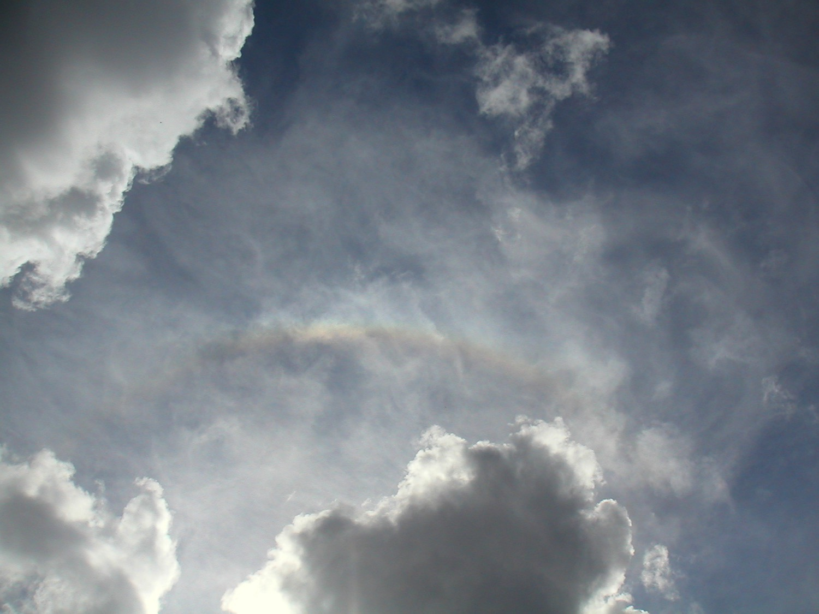
Only Three Things are Eternal
God
God's Word
People
So where should you invest your life?

Slide 87

Shouldn't I have pity on the 120,000 people of Nineveh?
JONAH
GOD
120,000 to judge
"You had pity on the plant…
120,000 to save
Barbarians
Naïve
Who cares for their animals?
"I do"
… and the animals as well?"
Notes:
87
B. We need to be like God, who is always more concerned about people than things (4:11).

Slide 88

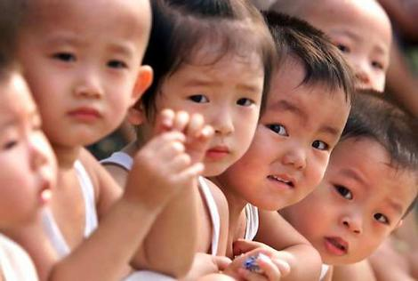
How can you have God's compassion for people?
Your time
Your money
Your view
Your ear
"If you don't share, then you don't care"
Notes:
Your time—keep an open door for conversation. Are you available when someone wants to talk? Or do the numerous tasks get in the way? While preparing this message, a neighbor of mine came over six nights in a row to talk about difficulties he's having with his son. So many times I wanted to say, "Hey, I can't afford this much time with you. I have to go prepare a message on giving people priority!"
Your money—is it invested in things or people? Do you give God your first fruits or your leftovers after you spend money on yourself?
Your view—how do you see people? We often see people's attractiveness, social status, or race. But I encourage you to see people not for what they are now, but what they will become after death—see that person as radiant, happy, eternally blessed in a place beyond imagination, or see the person as despondent, wretched, eternally suffering among flames. Take every chance to share the gospel.
Your ear—To see if you are compassionate, ask the person closest to you, "Am I a person of compassion?" Ask him or her right now if he or she is right next to you. Look for a nod and then the other person can ask the same question of you. If you're afraid to ask the question, you already know the answer.
88

Slide 89
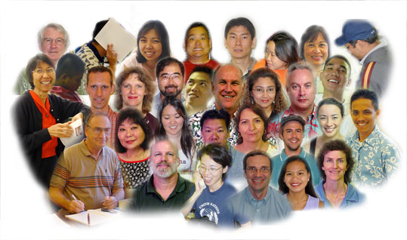
The Point of Jonah:
599
Make people the highest priority in your life.
Responding to God's heart means catching His heart for the lost.
Notes:
People are God's first concern—so people should be our first concern.
Imitate God's compassion for people by considering people more important than things.
Do you need to let some plates break?

Slide 90

Thought Questions
599
What parallels do you see between your life and Jonah?
What causes Christians—especially older ones—to lose their compassion for the lost?
What practices have you found helpful to maintain your compassion for unbelievers?
Notes:
90

Slide 91
Black
Notes:
91
Let's bow in prayer. But before we pray, honestly consider two questions:
Do others know you as compassionate—a "people person"? Why or why not?
2. What concern in your life hinders your concern for people? Studies? Perfectionism? A hobby which gobbles all your time? Not being able to say "no" to non-people-oriented tasks?
"Father, thank you for setting the example in your compassion on us. But help us to follow well in this area. May our comfort of persons be more important than our personal comforts. Show us how temporal things of this world really are—and how eternal people are—those for whom your Son died. In His precious name, Amen."

Slide 92


OT Sermons link at BibleStudyDownloads.org
Get this presentation and script for free!

